Slide 1


Wisconsin Faith Voices
For Justice
Annual Report 2013

Slide 2










    RELIGIOUS REPRESENTATION

Slide 3






ORGANIZATIONAL MEMBERSHIP
FUMC
Church and Society Mission Team

Slide 4

OUTREACH
    Facebook page
      www.facebook.com/WisconsinFaithVoicesForJustice
    Website
      www.wisconsinfaithvoicesforjustice.org
    ‘Discuss’ listserv
      discuss@wisfaithvoices.org
    Action alert emails on BadgerCare/Medicaid expansion; school voucher proposal; Farm Bill; FoodShare

Slide 5


HEALTH CARE
REFORM
Overview of the Governor’s BadgerCare Proposal and Tax-Saving Alternatives
(April 2013)
Affordable Care Act Petition

Slide 6
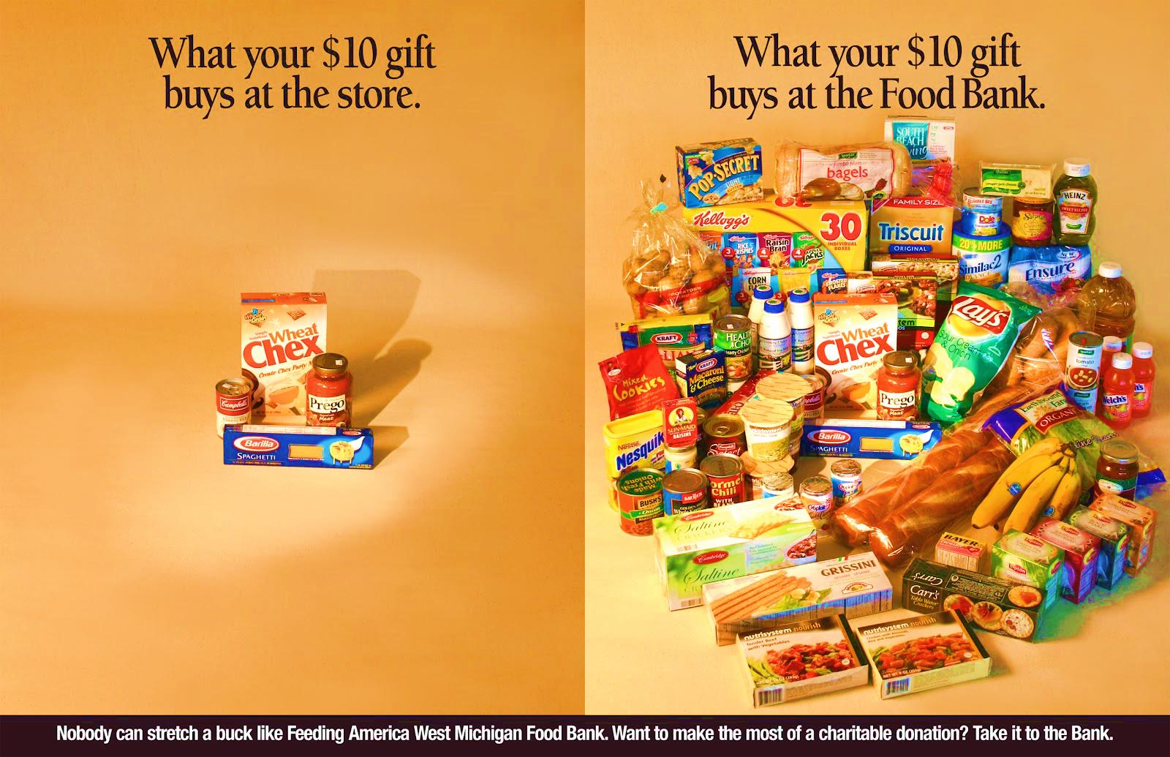
  HUNGER AND FOOD INSECURITY
    Launched Food Stamp Challenge Lent/Passover 2013

Slide 7





Slide 8



Creating barriers to FoodShare destabilizes lives.
“I’ve lived in states that had work requirements for food stamp benefits. While the idea of requiring work training time may be well meaning, in reality they never seem to be able to match talents to the right training. I spent half days sitting in an office waiting to answer a phone that never rang. It actually impeded my progress because I couldn’t go out to look for work during that time.” - Jacquelyn
What we need:
LIVING WAGE JOBS • PUBLIC TRANSPORTATION • PAID SICK LEAVE • CHILD CARE • HEALTH CARE • ENOUGH TO EAT
The Reality:
Most available jobs pay minimum or low-wages and do not offer benefits. Many are part-time. Requiring work or training for FoodShare benefits may create a worse situation for a family than before.
No health insurance? Some people require costly medications to keep them healthy and able to work.
Can’t afford a car, or don’t drive? Public transportation doesn’t always run at job or training sites, or stops before shifts end.
Have children? Single parents, nearly 2/3 of those living in poverty in Wisconsin, need childcare in order to attend classes or work. Parents need to miss work or training when children get sick.
Get sick? No paid leave means your take-home is reduced or you risk losing your job.
Many things can destabilize someone’s life:
Your car (or anything) breaks down
You need to pay for medication
Your shoes wear out
You take time off for a family emergency
You need new glasses
The bus is late
Close to half of FoodShare recipients
are ALREADY working.
Ellen works 40 hours a week at $9.50/hour.
INCOME:
Monthly gross income $1520
Withholding taxes -304
Total available for the month: $1216
EXPENSES:
Rent (1-bedroom) 577
Health insurance 183
Car insurance 54
Electricity & heat 121
Phone 50
Transportation (gas) 200
Total: $1185
Amount left for food*: $31
*Ellen is eligible for $16/month in SNAP benefits (FoodShare), giving her a total of $47 for an entire month’s worth of food.

Slide 9

  HOUSING AND HOMELESSNESS
In Dane County:
3136 = individuals who stayed at least one night in a Dane
County Shelter
1363 people in families
1235 single men
509 single women
29 unaccompanied youth
1371 = individuals turned away from shelters
85% were families with children
Unknown = the number of homeless who do not seek
assistance

Slide 10
LOOKING AHEAD
  Poverty Simulation
  Second annual Food Stamp Challenge
  Video project: shopping with FoodShare; cooking on a budget;
  Advocacy Training
  Outreach meetings around state
  Informational conference calls

